Slide 1
Leading Developer and Manufacturer of In Vivo and DNA Transfection Kits, Transfection Reagents and Electroporation Delivery Products
Products > Kidney In Vivo Transfection Kit
Efficient in vivo kidney-targeted delivery of nucleic acids and proteins is enabled with the Altogen® Biosystems Kidney in vivo Transfection Kit.
This product falls into the category of the versatile in vivo transfection kits that Altogen® Biosystems offers. Degradation of cargo molecules is minimized and delivery efficiency is maximized for any negatively charged molecules (DNA, RNA).
Huffingtonpost.com
Altogen Biosystems • 848 Rainbow Blvd #823 • Las Vegas • NV • 89107 • USA
Telephone • 702 349 6103 • Fax • 702 989-0841 • email • techserv@altogen.com

Slide 2
Leading Developer and Manufacturer of In Vivo and DNA Transfection Kits, Transfection Reagents and Electroporation Delivery Products
Products > Kidney In Vivo Transfection Kit
Summary
Modes of administration:
Systemic intravenous (i.v.) injection
Direct intratumoral (i.t.) injection
Intraperitoneal (i.p.) injection
Kidney-targeted In Vivo Transfection Reagent
Biodegradable lipid liposome-based reagent
Liposome conjugated complexes are stable in serum (16h)
Efficient delivery to the kidney tissue (via systemic administration) and kidney tumors (via intratumoral administration)
Efficient siRNA, shRNA, microRNA, and plasmid DNA delivery
Minimal toxicity
Functionally validated in mice and rats
Applicable for plasmid DNA/siRNA co-injection
Altogen Biosystems • 848 Rainbow Blvd #823 • Las Vegas • NV • 89107 • USA
Telephone • 702 349 6103 • Fax • 702 989-0841 • email • techserv@altogen.com

Slide 3
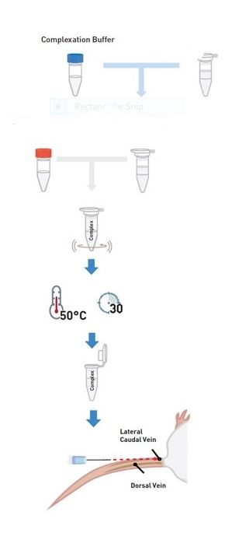
Leading Developer and Manufacturer of In Vivo and DNA Transfection Kits, Transfection Reagents and Electroporation Delivery Products
Products > Kidney In Vivo Transfection Kit
Cargo (nucleic acids, small proteins and plasmids)
In Vivo Kidney-Targeted Transfection Reagent
The general process is simple: mix, dilute, vortex and inject!
The hands-on time is less than 30 minutes
With the Altogen Biosystems kidney targeted Kit, less of the delivery cargo is required to achieve maximum mRNA knockdown
In Vivo Transfection Enhancer Reagent (optional to condense the complex)
Altogen Biosystems • 848 Rainbow Blvd #823 • Las Vegas • NV • 89107 • USA
Telephone • 702 349 6103 • Fax • 702 989-0841 • email • techserv@altogen.com

Slide 4
Leading Developer and Manufacturer of In Vivo and DNA Transfection Kits, Transfection Reagents and Electroporation Delivery Products
Products > Kidney In Vivo Transfection Kit
Administration with Transfection Kit
Systemic administration generally translates to clinical research better than localized administration, as diseases can require intravenous or intraperitoneal injections, while local administration can be beneficial over systematic in some cases as it requires lower doses and therefore produces lower side effects.
Altogen Biosystems tissue-targeted in vivo transfection kits also require less siRNA or DNA sample than other commercially available transfection reagents.
Intraperitoneal (i.p.) injection
Direct intratumoral (i.t.) injection
Tail vein systemic intravenous (i.v.) injection
Altogen Biosystems • 848 Rainbow Blvd #823 • Las Vegas • NV • 89107 • USA
Telephone • 702 349 6103 • Fax • 702 989-0841 • email • techserv@altogen.com

Slide 5
Leading Developer and Manufacturer of In Vivo and DNA Transfection Kits, Transfection Reagents and Electroporation Delivery Products
Products > Kidney In Vivo Transfection Kit
Product Details
Our kits are easy to use and effective: Mix, dilute, vortex, and inject!
Our kits allow for sustained mRNA knockdown after a single siRNA injection
Target kidney through different administration routes.
There is very low in vivo toxicity and it is safe to use as there is no detectable inflammatory response (ELISA).
Used for preclinical research worldwide!
Altogen Biosystems • 848 Rainbow Blvd #823 • Las Vegas • NV • 89107 • USA
Telephone • 702 349 6103 • Fax • 702 989-0841 • email • techserv@altogen.com

Slide 6
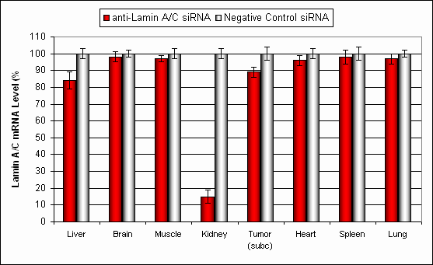
Leading Developer and Manufacturer of In Vivo and DNA Transfection Kits, Transfection Reagents and Electroporation Delivery Products
Products > Kidney In Vivo Transfection Kit
Data
Figure 1. Systemic administration (i.v.) of Kidney In Vivo Transfection Reagent conjugated with 80 ug of chemically modified siRNA targeting Lamin A/C mRNA or non-silencing control siRNA following the recommended protocol. Tissues (Liver, Brain, Muscle, Kidney, Tumor, Heart, Spleen, Lung) were collected and RNA isolated 24 hours after first injection. Samples were analyzed by qRT-PCR for Lamin A/C gene expression levels. Ribosomal RNA levels were used to normalize the Lamin A/C data. Data are means ± SD (n=7).

Slide 7
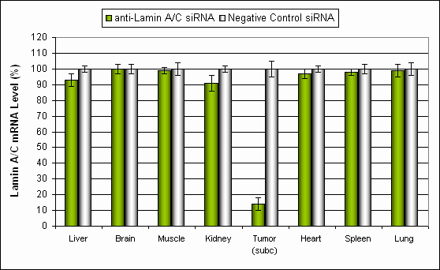
Leading Developer and Manufacturer of In Vivo and DNA Transfection Kits, Transfection Reagents and Electroporation Delivery Products
Products > Kidney In Vivo Transfection Kit
Data
Figure 2. Intratumoral administration (i.t.) of Kidney In Vivo Transfection Reagent conjugated with 80 ug of chemically modified siRNA targeting Lamin A/C mRNA or non-silencing control siRNA following the recommended protocol. Animal model is NOD/SCID xenograft mouse bearing flank tumor of human origin (kidney cancer cell line). Tissues (Liver, Brain, Muscle, Kidney, Tumor, Heart, Spleen, Lung) were collected and RNA isolated 24 hours after first injection. Samples were analyzed by qRT-PCR for Lamin A/C gene expression levels. Ribosomal RNA levels were used to normalize the Lamin A/C data. Data are means ± SD (n=7).

Slide 8
Leading Developer and Manufacturer of In Vivo and DNA Transfection Kits, Transfection Reagents and Electroporation Delivery Products
Products > Kidney In Vivo Transfection Kit
Data
Figure 3. Systemic administration (i.v.) of Kidney In Vivo Transfection Reagent conjugated with 80 ug of chemically modified siRNA targeting Lamin A/C mRNA or non-silencing control siRNA following the recommended protocol. Tissues (Liver, Brain, Muscle, Kidney, Tumor, Heart, Spleen, Lung) were collected and total protein fraction isolated 72 hours after first injection. Samples were analyzed by Western Blot Analysis for Lamin A/C gene expression levels.

Slide 9
Leading Developer and Manufacturer of In Vivo and DNA Transfection Kits, Transfection Reagents and Electroporation Delivery Products
Products > Kidney In Vivo Transfection Kit
Data
Figure 4. Systemic administration (i.v.) of Kidney In Vivo Transfection Reagent conjugated with 80 ug of chemically modified siRNA targeting Lamin A/C mRNA or non-silencing control siRNA following the recommended protocol. Tissues (Liver, Brain, Muscle, Kidney, Tumor, Heart, Spleen, Lung) were collected and total protein fraction isolated 72 hours after first injection. Samples were analyzed by Western Blot Analysis for Lamin A/C gene expression levels.

Slide 10
Leading Developer and Manufacturer of In Vivo and DNA Transfection Kits, Transfection Reagents and Electroporation Delivery Products
Products > Kidney In Vivo Transfection Kit
Data
Figure 5. Systemic administration (i.v.) of Kidney In Vivo Transfection Reagent conjugated with 80 ug of chemically modified siRNA targeting Lamin A/C mRNA or non-silencing control siRNA following the recommended protocol. Tissues (Liver, Brain, Muscle, Kidney, Tumor, Heart, Spleen, Lung) were collected and total protein fraction isolated 72 hours after first injection. Samples were analyzed by Western Blot Analysis for Lamin A/C gene expression levels.

Slide 11
Leading Developer and Manufacturer of In Vivo and DNA Transfection Kits, Transfection Reagents and Electroporation Delivery Products
Products > Kidney In Vivo Transfection Kit
Data
Figure 6. Systemic administration (i.v.) of Kidney In Vivo Transfection Reagent conjugated with 80 ug of chemically modified siRNA targeting Lamin A/C mRNA or non-silencing control siRNA following the recommended protocol. Tissues (Liver, Brain, Muscle, Kidney, Tumor, Heart, Spleen, Lung) were collected and total protein fraction isolated 72 hours after first injection. Samples were analyzed by Western Blot Analysis for Lamin A/C gene expression levels.

Slide 12
Leading Developer and Manufacturer of In Vivo and DNA Transfection Kits, Transfection Reagents and Electroporation Delivery Products
Products > Kidney In Vivo Transfection Kit
Product Details
Contents and Shipping: Kidney in vivo transfection reagent is supplied in liquid form at a concentration of 2.5 mg/ml. Shipped at ambient temperature. Transfection Enhancer reagent is supplied in liquid form at a concentration of 1 mg/ml.
Description: Kidney transfection reagent is a nanoparticle-based liposomal formulation optimized for in vivo administration with targeted kidney delivery. Kidney in vivo transfection reagent is a proprietary, animal-origin-free formulation with high transfection efficiency of small RNA (siRNA, shRNA, microRNA) and plasmid DNA.
Product Qualification: Reagents are tested for functional activity, absence of nuclease contamination and microbial contamination.
Reagent Properties: Nanoparticle-based liposome conjugated complexes are stable in serum for at least 16 hours. Efficient delivery to the kidney and kidney tumors via systemic administration. Efficient siRNA and plasmid DNA delivery via direct intratumoral injection. Minimal toxicity.
Altogen Biosystems • 848 Rainbow Blvd #823 • Las Vegas • NV • 89107 • USA
Telephone • 702 349 6103 • Fax • 702 989-0841 • email • techserv@altogen.com

Slide 13
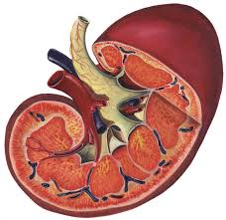
Leading Developer and Manufacturer of In Vivo and DNA Transfection Kits, Transfection Reagents and Electroporation Delivery Products
Products > Kidney In Vivo Transfection Kit
Potential Clinical Applications of Kidney Targeted Delivery Kit
Acute kidney injury
Chronic renal diseases (renal fibrosis and autoimmune nephritis)
Other renal diseases, glomerular diseases
Gene therapy to transplanted kidneys in order to improve graft outcomes by reducing potential acute and chronic rejections
Therapeutics to address genetic deficiencies of the native kidney
www.kaneexterminating.com
Healthtap.com
Cidmcorp.com
Altogen Biosystems • 848 Rainbow Blvd #823 • Las Vegas • NV • 89107 • USA
Telephone • 702 349 6103 • Fax • 702 989-0841 • email • techserv@altogen.com

Slide 14
Leading Developer and Manufacturer of In Vivo and DNA Transfection Kits, Transfection Reagents and Electroporation Delivery Products
Products > Kidney In Vivo Transfection Kit
Benefits of Kidney-Targeted Delivery Kit
Our kits and protocols straightforward, easy to use and effective: Mix, dilute, vortex, and inject!
Our kits allow for sustained mRNA knockdown after a single siRNA injection
Target kidney through different administration routes.
There is very low in vivo toxicity and it is safe to use as there is no detectable inflammatory response (ELISA).
Used for preclinical research worldwide!
Altogen Biosystems • 848 Rainbow Blvd #823 • Las Vegas • NV • 89107 • USA
Telephone • 702 349 6103 • Fax • 702 989-0841 • email • techserv@altogen.com

